Slide 1
Data Acquisition and Analysis Basics
OCE2901 – Surf Engineering Analysis

Slide 2

Introduction What is data acquisition?
What does it mean to collect data?
How do you meaningfully analyze data?

Slide 3
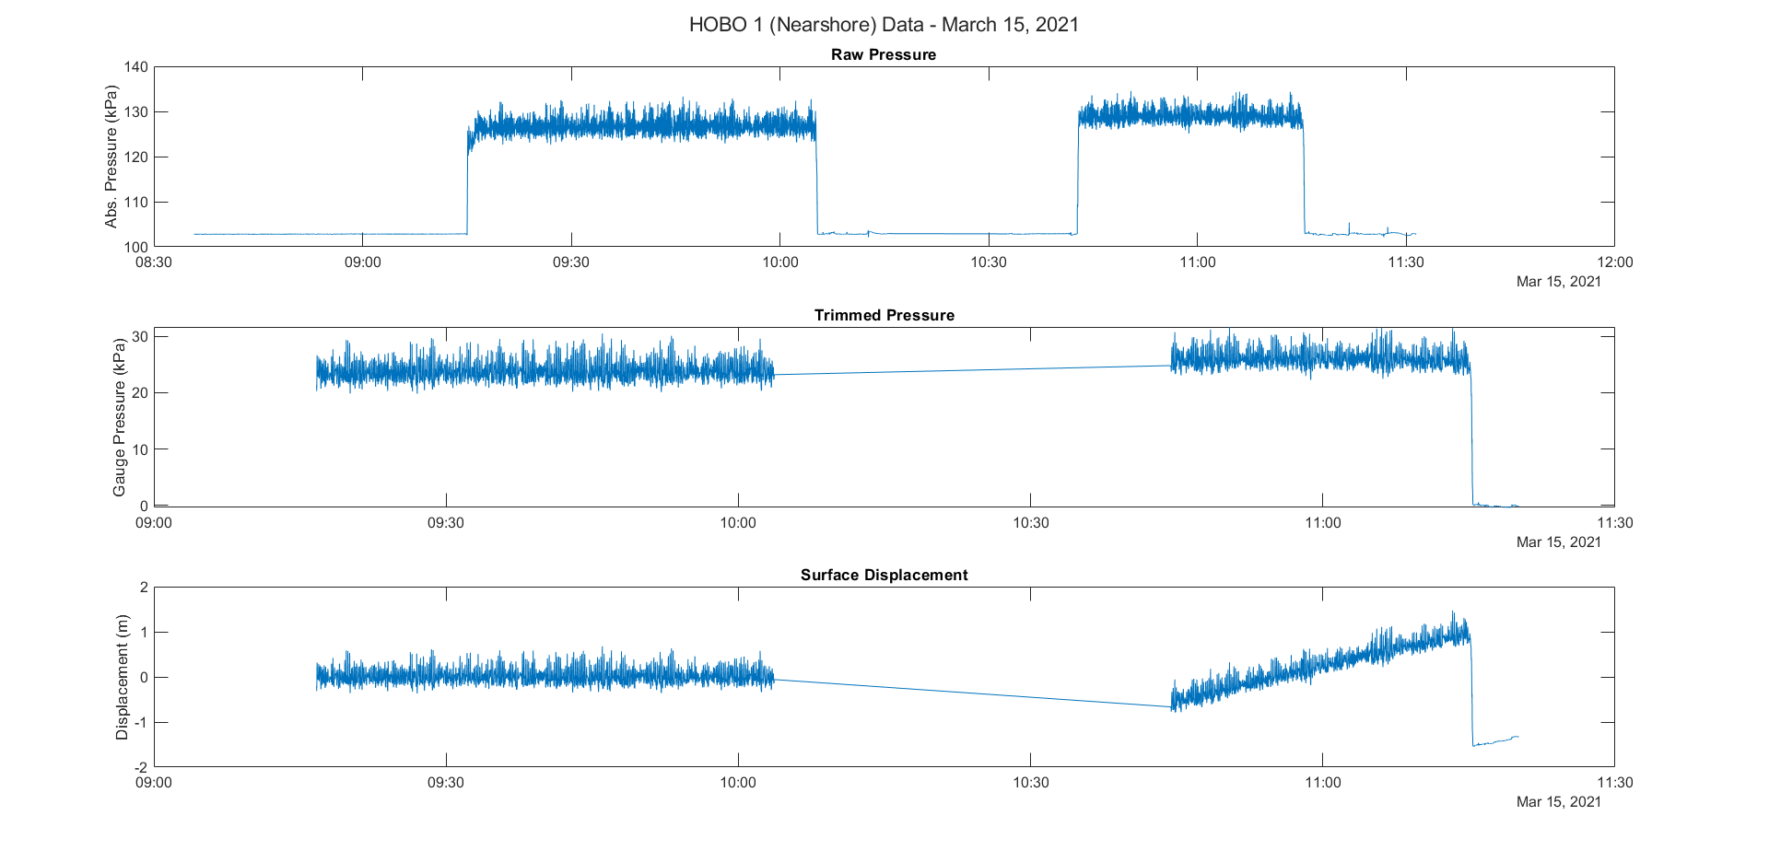

Basic Terminology
Time Series: successive data points generally measured with an equal time interval between samples
Samples: measurements provided by sensors and put into the series or population
Sample Frequency: the number of samples taken per second defined as:
$$f_{S}=\frac{1}{Δt_{s}}$$

Slide 4
The Rules of Acquisition
Making your Data Collection More Profitable

Slide 5
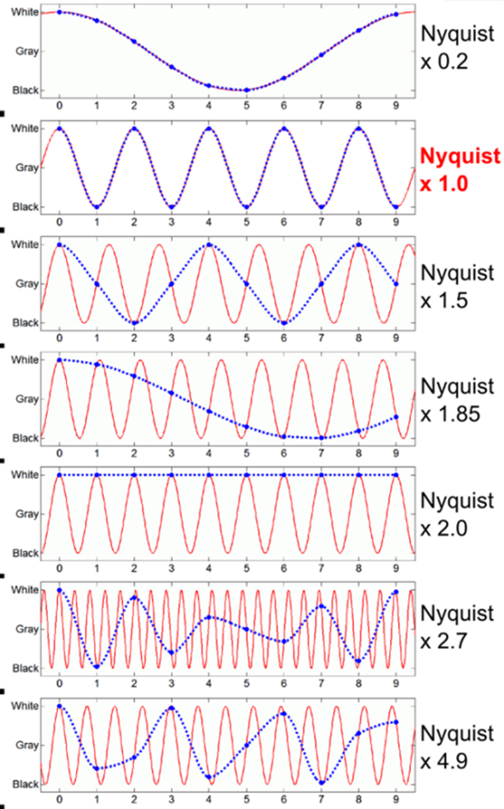
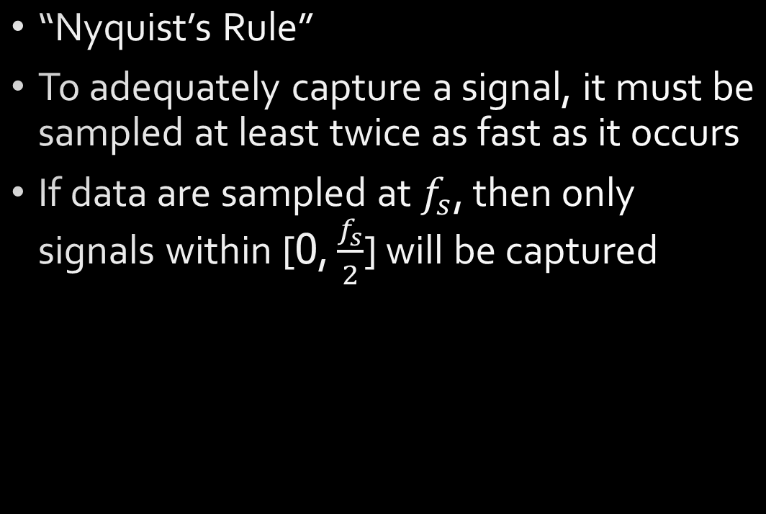
Rule #1: Thou shall not sample at less than twice the signal frequency
“Nyquist’s Rule”
To adequately capture a signal, it must be sampled at least twice as fast as it occurs
If data are sampled at $f_{s}$, then only signals within [0, $\frac{f_{s}}{2}$] will be captured
If the fastest waves in an area of interest are expected to have 8-second periods (0.125 Hz), what is the minimum sample rate for a pressure gauge recording the sea surface elevation?

Slide 6

CONSIDERATIONS
Balancing the need of the experiment versus the limitations of the instrument is important!
Higher sample rates will capture higher frequency signals, but may introduce more noise and will take more storage and power
Lower sample rates will attenuate high frequency signals but save considerably on storage and power costs.

Slide 7
Rule #2: Thou shall measure in either continuous or burst modes
Continuous Measurements: are taken in an uninterrupted time series.
This method is best for short deployments or experiments where the signal can unpredictably change
Burst Measurements are taken after the instrument is awoken and samples taken for a certain time period $(Δt_{bl})$ before going back to sleep
Burst Measurements are taken after the instrument is awoken and samples taken for a certain time period (Δt_bl) before going back to sleep
Can be expressed as a duty cycle that can be multiplied to memory or power consumption metrics to estimate savings
Burst sampling can dramatically increase deployment lengths given memory or power constraints.
$$DC=\frac{time sampling}{time sampling+time asleep}=\frac{t_{bl}}{t_{bl}+Δt_{bl}}$$
𝐷𝐶=(time sampling)/(time sampling+time asleep)=𝑡_𝑏𝑙/(𝑡_𝑏𝑙+Δ𝑡_𝑏𝑙 )

Slide 8
Rule #3: Thou shall appropriately window your data
To analyze blocks of data, you must set lower and upper limits to your series
The chosen window must represent the data in a steady-state.
Data within the window should have enough samples to make a statistically significant representation of present relationships
In this course, why is windowing especially important?

Slide 9
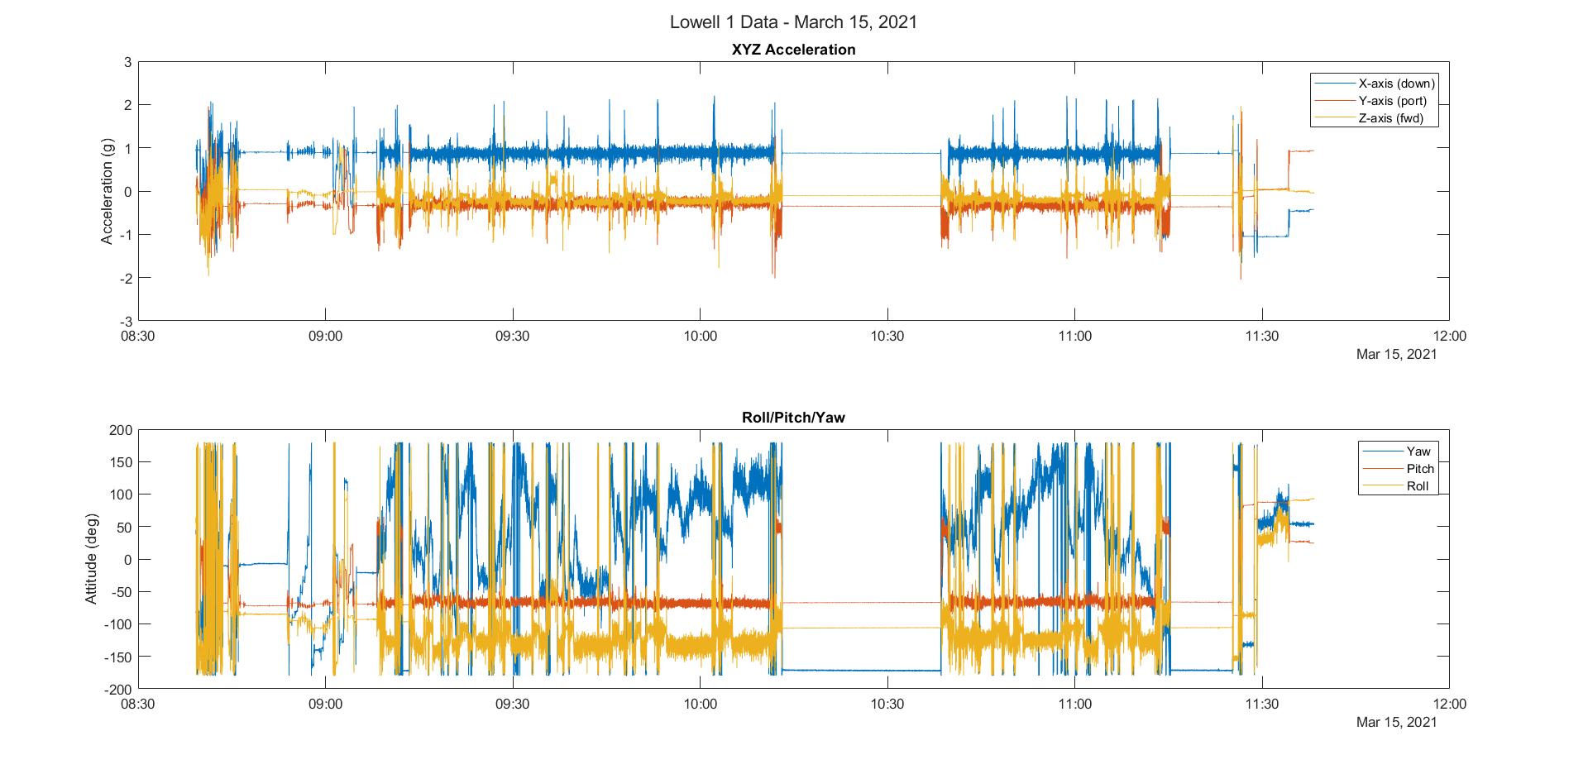


Slide 10
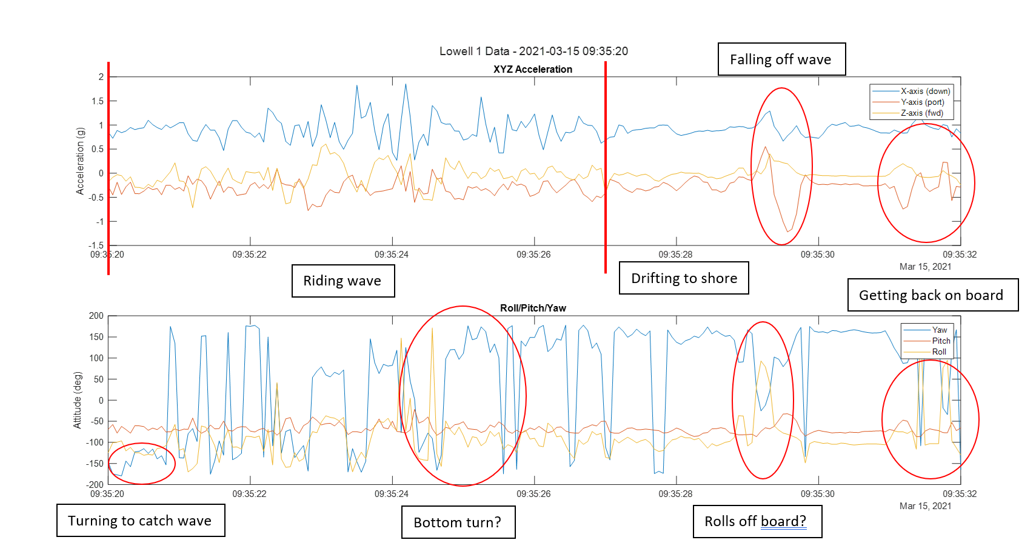

Slide 11
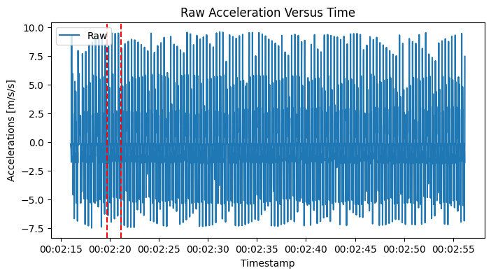
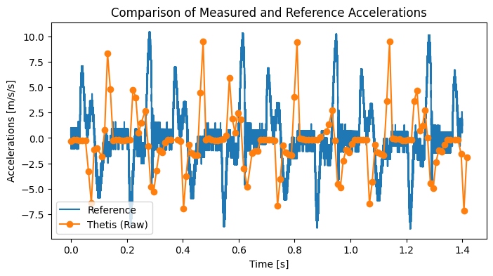

Slide 12
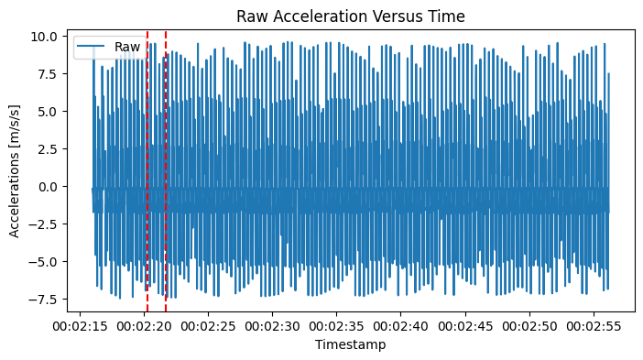
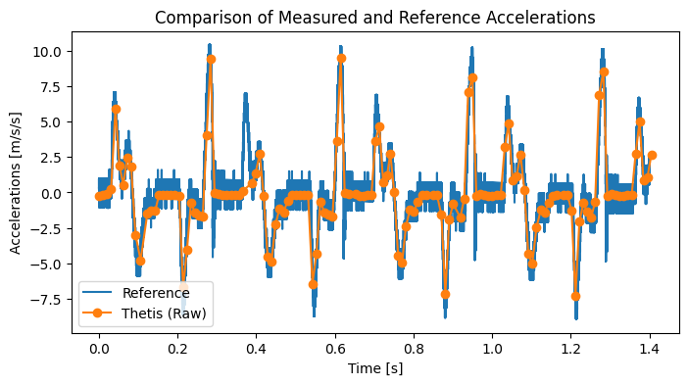

Slide 13
Rule #4: Thou shall control the quality of your data
Always ensure your data passes a sanity check
It is best to “de-spike” your data by identifying sudden, unacceptable rises or drops in your measurements
Replace the values with an interpolated or averaged value
Same goes for any missing data or non-sensical data
Note: if large portions of your data need quality controlled, your dataset may no longer be reliable!

Slide 14
Rule #5: Thou shall detrend your data
In time series analysis, the ideal signal should have an average value of “0” across the entire population
Some trends may get introduced as the experiment is conducted
For these instances, we must “detrend” the data by subtracting the rolling average of a window across the dataset; this should make the signal oscillate about 0

Slide 15

Dice Roll Programming Assignment
TODAY!
You have me for the rest of class to ask for advice or seek answers to any questions

Slide 16

Literature Review Quad Chart
Graduate students only!
Friday, January 27

Slide 17

Questions?

